Slide 1
ADO.Net
The ADO.Net object structure
Connecting
Commanding
Readers and DataSets

Slide 2
What is ADO.Net
The data access classes for the .Net framework
Designed for highly efficient data access
Support for XML and disconnected record sets

Slide 3


Where does ADO.Net Sit
C#
VB
JS
…
Common Language Specification
ASP.Net
Windows Forms
^{Visual Studio .Net}
ADO.Net
XML.Net
Base Class Library
Common Language Runtime
Windows API
COM+ Services

Slide 4

.Net Data Providers
SQL.Net
SQL Server
OLEDB
OLEDB Data Provider
Client
Other DB
ODBC
ODBC Data Provider
Other DB

Slide 5
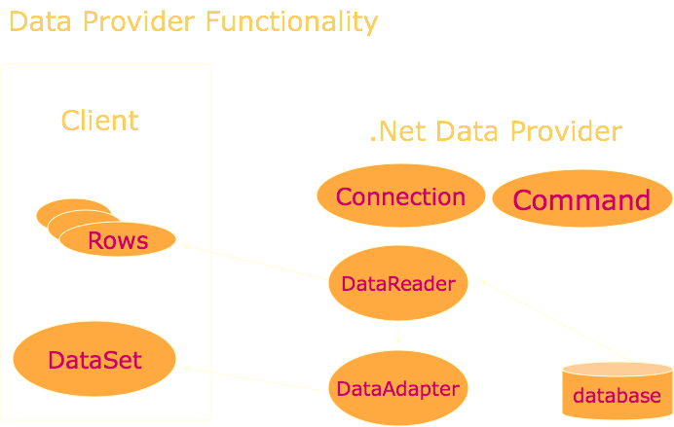

Slide 6
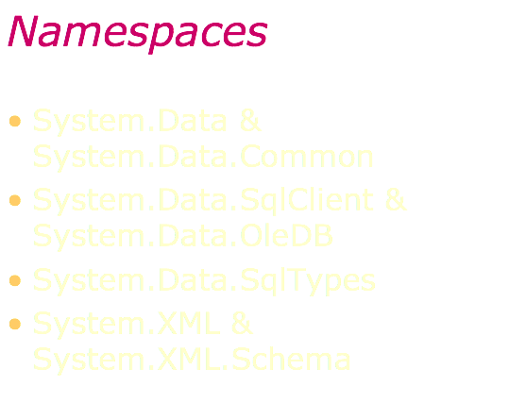

Slide 7
Namespaces
System.Data
System.Data.Common
System.Data.SqlClient
System.Data.OleDb
{
SqlConnection
SqlCommand
SqlDataReader
SqlDataAdapter
SqlParameter
SqlParameterCollection
SqlError
SqlErrorCollection
SqlException
SqlTransaction
SqlDbType
}

Slide 8
Using Data Adapter
using System.Data.SqlClient; string sConnectionString = "Initial Catalog=Northwind; Data Source=localhost; Integrated Security=SSPI;"; SqlDataAdapter sqlAdp= new SqlDataAdapter(sConnectionString); sqlAdp.Close(); sqlAdp.Dispose();

Slide 9
Connection Pooling
ADO.Net pools connections. When you close a connection it is released back into a pool.
SqlConnection conn = new SqlConnection(); conn.ConnectionString = "Integrated Security=SSPI;Initial Catalog=northwind"; conn.Open(); // Pool A is created.
SqlConnection conn = new SqlConnection(); conn.ConnectionString = "Integrated Security=SSPI;Initial Catalog=pubs"; conn.Open(); // Pool B is created because the connection strings differ.
SqlConnection conn = new SqlConnection(); conn.ConnectionString = "Integrated Security=SSPI;Initial Catalog=northwind"; conn.Open(); // The connection string matches pool A.

Slide 10
Demo..
string sSelectQuery = "SELECT * FROM Categories ORDER BY CategoryID"; string sConnectionString = "Initial Catalog=Northwind; Data Source=localhost; Integrated Security=SSPI;”;
SqlConnection objConnect = new SqlConnection(sConnectString);
SqlCommand objCommand = new SqlCommand(sSelectQuery, objConnect);
/*
objCommand.CommandTimeout = 15; objCommand.CommandType = CommandType.Text;
*/ objConnect.Open(); SqlDataReader drResults; drResults = objCommand.ExecuteReader() drResults.Close(); objConnect.Dispose();

Slide 11
Command Methods
.ExecuteReader() - Returns DataReader
.ExecuteNonQuery() - Returns # of Rows Affected
.ExecuteXMLReader() - Returns XMLReader Object to Read XML documentation
.ExecuteScaler() - Returns a Single Value e.g. SQL SUM function.

Slide 12
DataReader object
DataReader objects are highly optimized for fast, forward only enumeration of data from a data command
A DataReader is not disconnected.
Access to data is on a per record basis.
Forward only
Read only
Does support multiple record sets

Slide 13
Data Reader Demo..
SqlDataReader sqlReader;
sqlReader = sqlCommand.ExecuteReader();
while (sqlReader.Read())
{
// process, sqlReader("field")
}
sqlReader.Dispose();

Slide 14
DataSets
In-memory representation of data contained in a database/XML
Operations are performed on the DataSet, not the data source
A DataSet contains one or more DataTables.
Fields are held within the DataTable.And in DataRows, DataColumns.
Setup SqlConnection
Setup a SqlDataAdapter
Create a DataSet
Call the .Fill() method on the DA

Slide 15
Data Adapter
Pipeline between DataSets and data sources
Geared towards functionality rather than speed
Disconnected by design
Supports select, insert, delete, update commands and methods
Must always specify a select command
All other commands can be generated or specified

Slide 16
Data Adapter Demo..
SQLDataAdapter sqlDA = new SqlDataAdapter();
sqlDA.SelectCommand = new SqlCommand ("select * from authors“, sqlConnection);
DataSet sqlDS = new DataSet("authorsTable");
sqlDA.Fill(sqlDS, "authorsTable");

Slide 17
?

